Slide 1
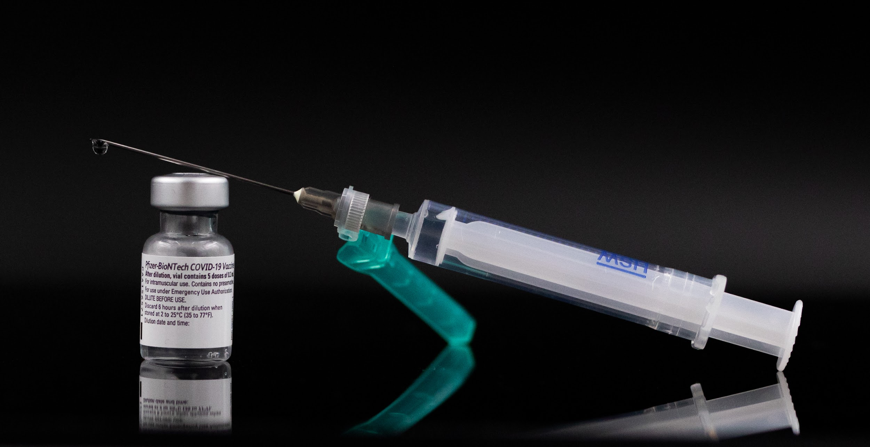
COVID VACCINATION TOKEN BOOKING
GOAL DIGGERS
SNEHA T

Slide 2


PROBLEM
We Coimbatore corporation are facing issues in regulating the crowd who are coming to book vaccination slots directly. Need to develop robust and innovative solutions for COVID 19 vaccnation drive slot booking for different user personas. All the bookings need to be managed centrally in a single system
IDEA
To create a website where we can register for the vaccination.
First register using email id or phone number. Link Aadhar card for proof and give necessary details.
Then enter pin code to how available centers or hospitals near you with vacant spots.
Select the required date for the vaccination. Then select if you require free vaccine or paid vaccine and then select the preferred vaccine.
Pre-booking of vaccination is available
Confirm the booking by entering the OTP sent to your number.
For paid vaccinations online payment is available. Can be paid through Gpay, Paytm or bank transaction.
People with no smart phones are given with a mobile number they can make phone calls and register their slot.

Slide 3
Technological stack
PYTHON
DEEP LEARNING FRAMEWORKS - TENSOR FLOW , KERAS, PYTORCH, CAFFE, MXNET,
COGNITIVE TOOLKIT
DATA STORAGE - CLOUD

Slide 4
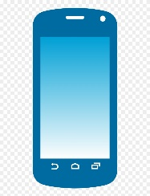





Conceptual Diagram
Website
User Login
Cloud
Database
Vaccination Center
Call

Slide 5





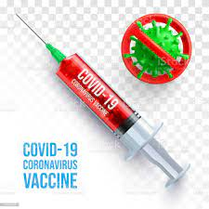
Usecase Diagram
User login
User
Register using mobile number
Getting Aadhar Number
Paid or unpaid
Area Pin code
Toll-free number
Select Dose and Preferred Vaccine
Available Slots
Make a call
Token number, Date and Time
Confirmation Through OTP

Slide 6
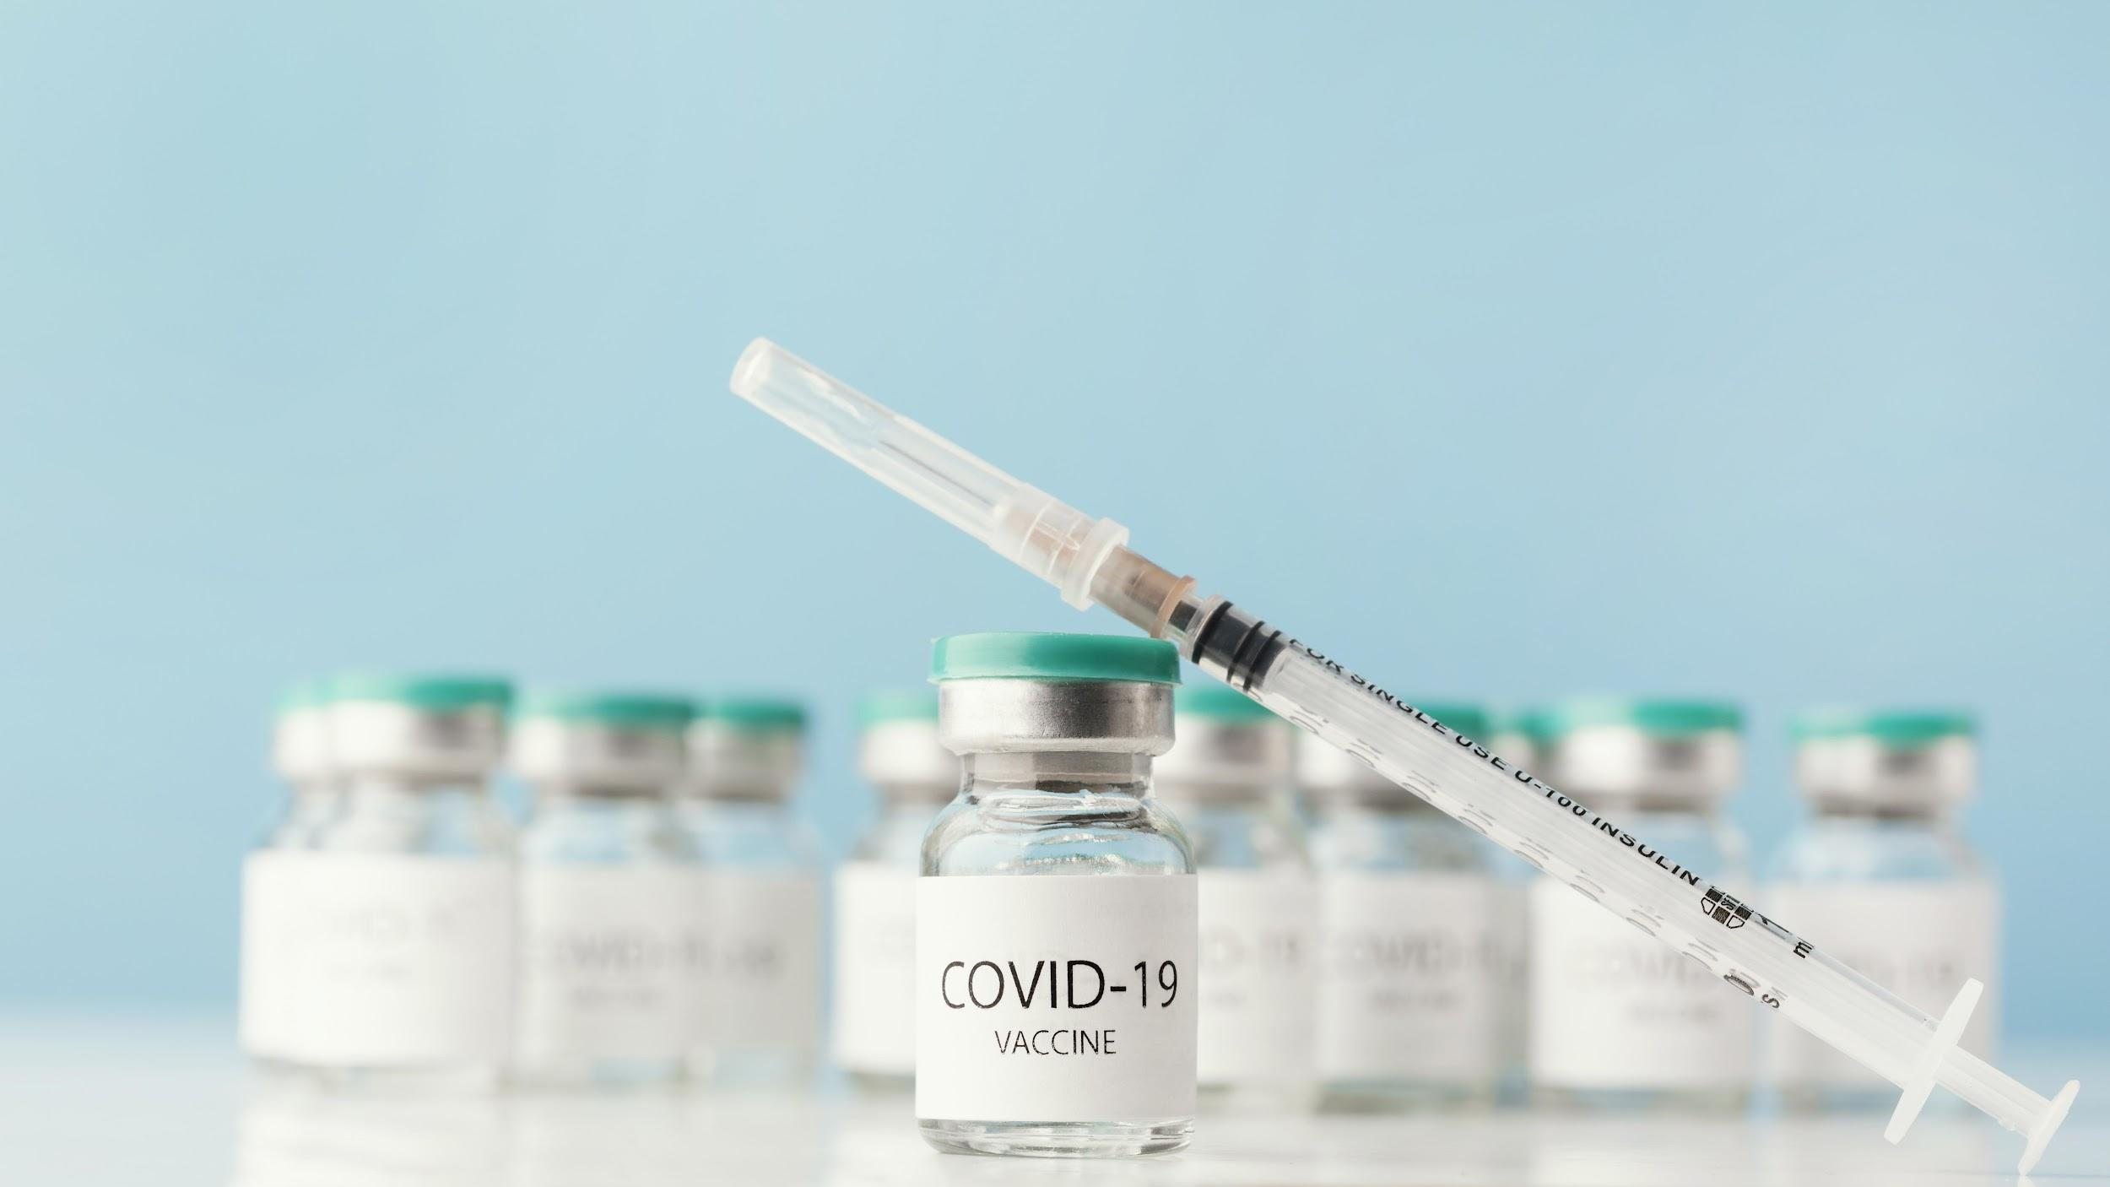
THANK YOU !!!

